Slide 1


SaaS Complaint Management System
Senior Project By :
Raghad Hredeen Rahma Al_Refai Rawaa Rabaa
Supervisor :
Eng . Anas Abdulaziz Dr. Mohib Al-Naqri
2026 –October– 31

Slide 2
Introduction
The Challenge: Lack of secure local platforms for internal complaint management, relying on slow, inaccurate manual methods.
Project Concept: A smart Multi-Tenant SaaS platform providing full data isolation for each organization (Schema-per-Tenant).
Tech Stack & Features: Fast React.js frontend with interactive Kanban Board, robust FastAPI core, Audit Logs, and full bilingual support.
AI Automation: Automated Arabic complaint classification (AraBERT) to determine responsible departments and priority levels.

Slide 3
Problem Statement
Organizations handling internal complaints lack a localized, Arabic-supported multi-tenant platform that automates complaint intake, intelligent classification, and automated routing to designated departments and agents. Without a fully isolated system offering real-time tracking, priority assessment, audit logging, and automated notifications, organizations suffer from slow and inaccurate manual classification, delayed response times, misplaced complaints, lack of accountability, and diminished operational transparency

Slide 4
How We Plan To Solve It
1
2
3
Multi-Tenant SaaS Architecture
AI-Driven Automation
End-to-End Lifecycle Tracking
5
4
Hybrid Architecture
Accountability & Compliance

Slide 5
Proposed Solution
1
2
3
AI-Powered Classification & Intelligent Routing
Tenant Isolation & Complete Security
Internal Complaint Lifecycle Management & Transparency
5
4
6
Accountability & Comprehensive Auditing (Audit Logs & Notifications)
Hybrid Architecture & Scalability
Ease of Setup & Tenant Environment Configuration

Slide 6
Reference Study Comparative Table :
Feature-by-Feature Analysis
System feature | Zendesk | Freshdesk | Os Ticket | Remedy (BMC) | Our System
هيكلية متعددة المستاجرين (multi-tenant) | ✓ | ✓ | ✗ | ✓ | ✓
معالجة متقدمة للغة العربية )Arabic NLP) | ✗ | ✗ | ✗ | ✗ | ✓
التصنيف التلقائي للشكاوي بالذكاء الاصطناعي | ✓ | ✓ | ✗ | ✓ | ✓
التوجيه الذكي للشكاوي (Intelligent Routing) | ✓ | ✓ | ✗ | ✓ | ✓
لوحات تقدم وتقارير متقدمة (Analytics) | ✓ | ✓ | ✗ | ✓ | ✓
سهولة الاعداد والتخصيص للمؤسسات المحلية | ✗ | ✗ | ✓ | ✗ | ✓
توفيرتكاليف الاشتراكات الباهظة (SaaS Cost) | ✗ | ✗ | ✓ | ✗ | ✓
الاستضافة المستقلة والامنة لكل جهة | ✓ | ✗ | ✓ | ✓ | ✓

Slide 7
Bilingual Support & Operational Fit
Arabic Multi-Tenant SaaS Platform:
Deliver a user-friendly, bilingual interface (Arabic & English) tailored specifically to meet operational requirements
6
1
Build a dedicated Arabic-supported Multi-Tenant SaaS platform that allows organizations to manage complaints without building custom systems or relying on tools that lack Arabic support
  Transparency & Auditability
Maintain comprehensive audit logs for all actions and send automated email notifications to ensure complete operational transparency
PROJECT
OBJECTIVES
2
5
Isolated Environment &
Security:
Provide each organization (tenant) with a fully isolated environment to handle and track internal complaints securely
Intelligent Routing & Lifecycle Tracking:
4
3
AI-Powered Automated Classification:
Route complaints to designated agents and track their entire lifecycle from intake to final resolution
Leverage AI to automatically analyze complaint text, determine the target department, categorize issues, and assign priority levels

Slide 8
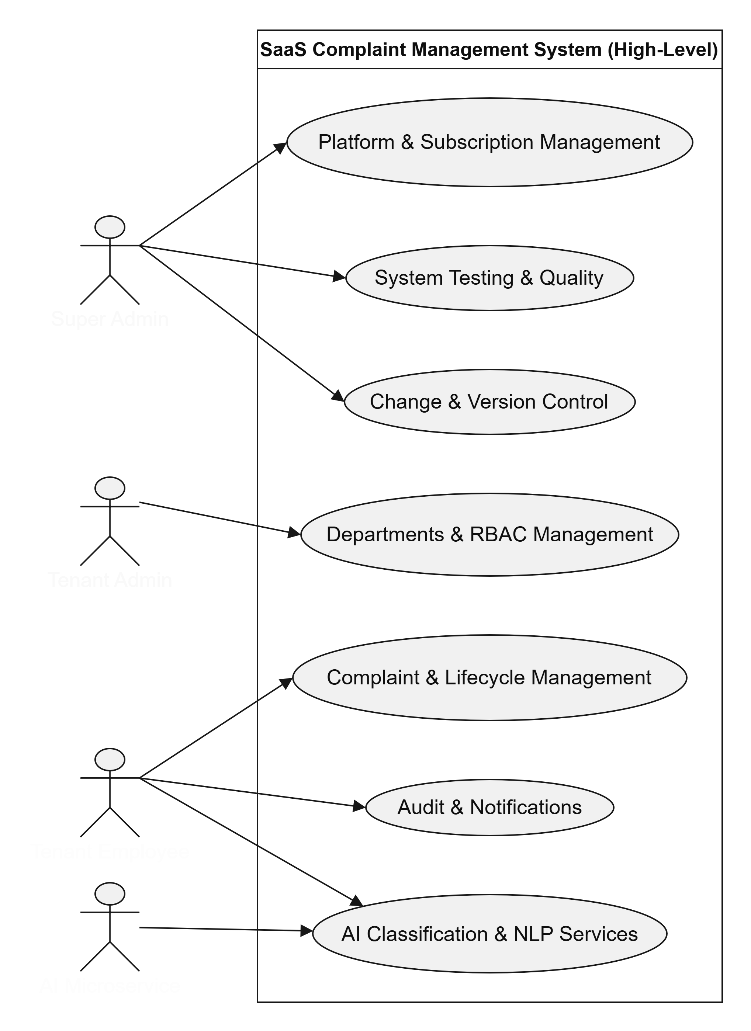
High – Level
Use Case Diagram

Slide 9
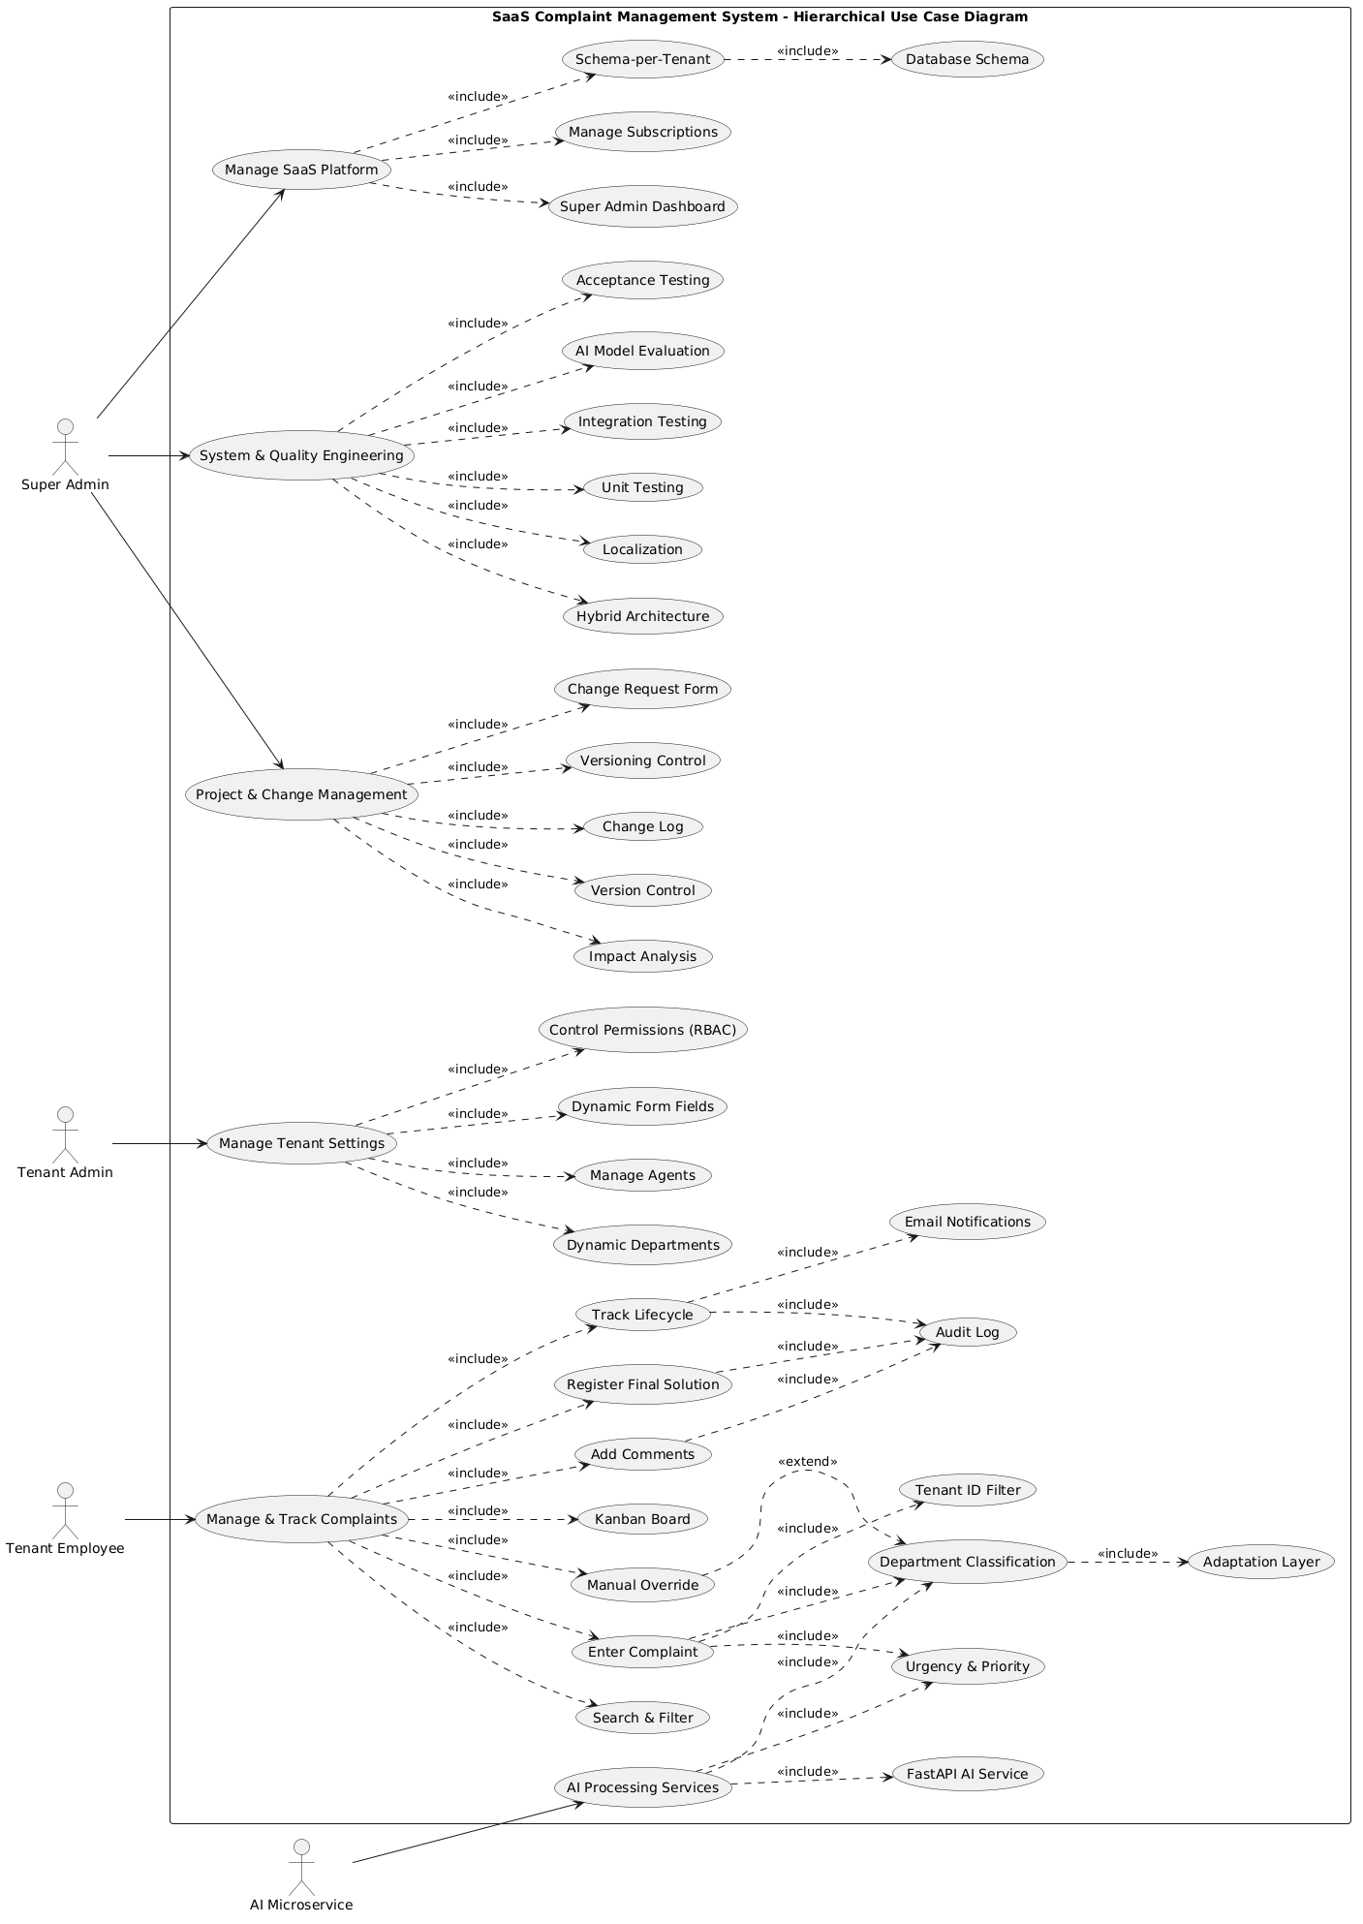
Low - Level
Use Case Diagram

Slide 10
Methodology & Architecture
1. Development Methodology:
· Agile / Scrum Methodology: Utilizing short work cycles (Sprints)—lasting one to two weeks—to accelerate development and updates.
· Why?:
· To ensure flexibility in task breakdown and distribution across the team (Frontend, Backend, and AI).
· To maintain continuous progress tracking through regular meetings (Daily Standups) and task management via GitHub Projects.
· To facilitate the incremental development of system features, with periodic demonstrations (Demos) provided to supervisors to ensure the quality of the deliverables.

Slide 11
System Architecture:
· Hybrid Layered-Microservice Architecture: A hybrid architecture that combines a multi-layered approach—used for the core and interfaces—with a microservices-based approach for text processing and artificial intelligence.
· Why ? :
· Tenant Isolation and Data Security: Utilizing a "schema-per-tenant" architecture within the PostgreSQL database, combined with strict "Tenant ID" filters, to safeguard each company’s data and prevent any cross-tenant data leakage.
· AI Performance: Decoupling AI services into an independent microservice (built with FastAPI and models such as AraBERT/Jeff) ensures that text processing and complaint classification tasks do not compromise the speed or responsiveness of the core platform during periods of high load.
· Parallel Development: Enabling the backend (FastAPI), AI service, and frontend (React.js) teams to work concurrently without conflicts in the codebase.
· Responsive UI: Leveraging React.js and Tailwind CSS to deliver flexible, bilingual (Arabic/English) interfaces, featuring an interactive Kanban board for seamless complaint management.

Slide 12
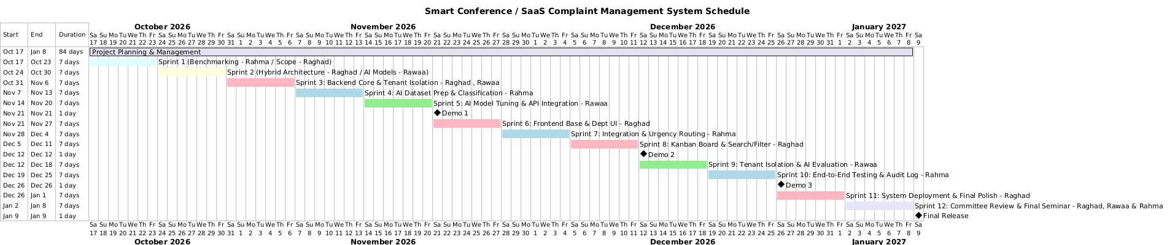
Gantt chart:

Slide 13
Technology Used
Frontend
Backend
Built with React.js for interactive and responsive user interfaces.
Styled using Tailwind CSS.
Features an interactive Kanban Board for complaint tracking.
Developed using Python and FastAPI to handle business logic, authentication, and API endpoints.
Manages data isolation, permissions, and
AI & NLP Models
Database & Multi-Tenancy
Independent AI Microservice built with FastAPI.
Utilizes AraBERT for automated Arabic text classification, department routing, and priority assessment.
Powered by PostgreSQL.
Implements Schema-per-Tenant isolation combined with a strict Tenant ID Filter.

Slide 14
Thanks you

